Slide 1
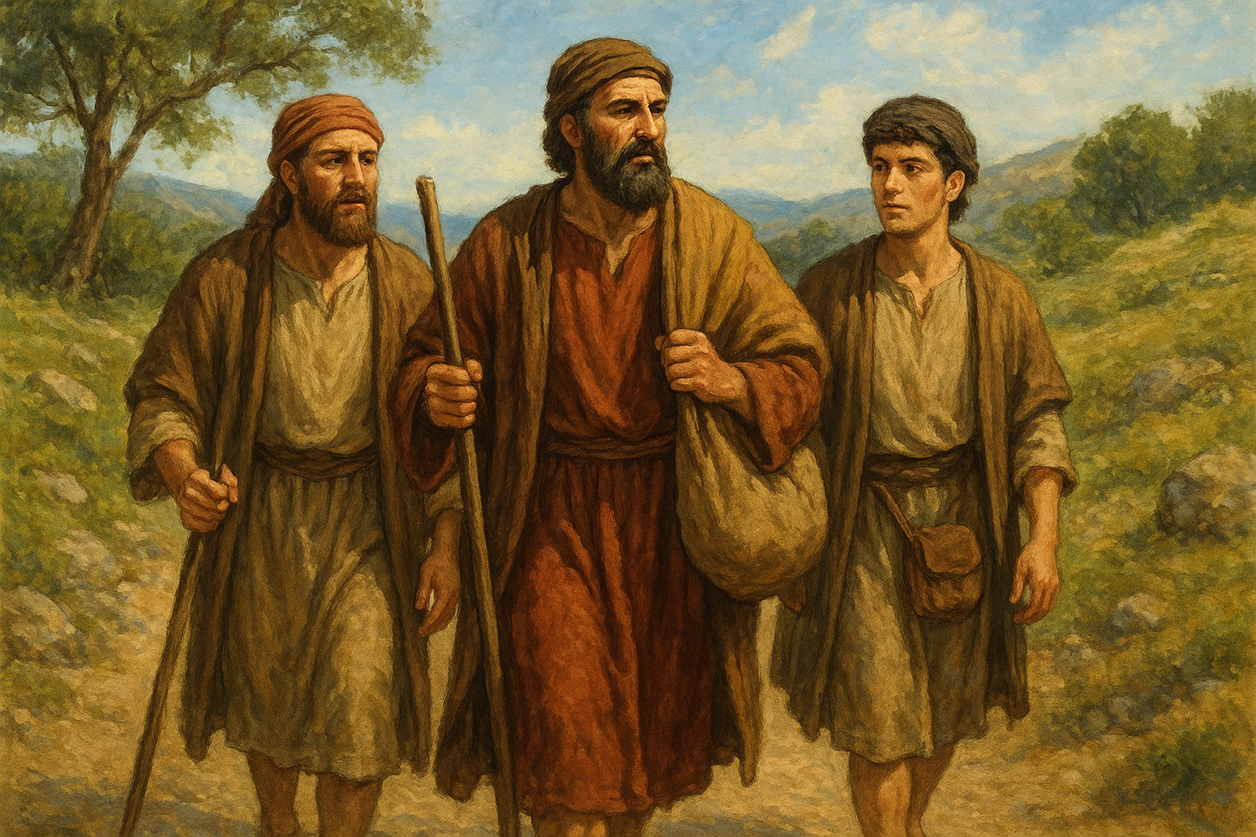
Acts, part 1
Lesson 19
Acts 12:25-13:12

Slide 2
General Introduction
Text Acts 1:1 – 15:35
Begins with Jesus’ ascension
Coming of the N.T. kingdom, its early growth in & around Jerusalem (Jews)
The kingdom spreads out from Judea/Samaria & into the world (Gentiles)
Concludes with 1st journey & “Jerusalem Conference” re: circumcision
Outlines For The Book (Helpful to see the book’s message)
Textually Acts 1:8 [Jesus’ orders for the apostles’ work] Jerusalem Acts 1-7 Judea & Samaria Acts 8-12 Earth Acts 13-28
Topically [Arranged by the book’s “apostolic emphasis”]
Apostle Peter Acts 1-12 Apostle Paul Acts 13-28

Slide 3
To Antioch from Jerusalem
They had taken relief to the brethren dwelling in Judea (Acts 11:28-30)
Their mission complete, they return to Antioch (Acts 12:25)
Mark was with them
He will later travel with them on first preaching journey
Later near the end of Paul’s life he will send for Mark (2 Timothy 4:11)
Notes:
Ac 11:28 Then one of them, named Agabus, stood up and showed by the Spirit that there was going to be a great famine throughout all the world, which also happened in the days of Claudius Caesar.
29 Then the disciples, each according to his ability, determined to send relief to the brethren dwelling in Judea.
30 This they also did, and sent it to the elders by the hands of Barnabas and Saul.
Ac 12:25 And Barnabas and Saul returned from Jerusalem when they had fulfilled their ministry, and they also took with them John whose surname was Mark.
2Ti 4:11 Only Luke is with me. Get Mark and bring him with you, for he is useful to me for ministry.

Slide 4
Prophets and Teachers at Antioch
Barnabas
Simeon called Niger
Lucius of Cyrene
Manaen (brought up with Herod the tetrarch)
Saul
Notes:
Ac 13:1 Now in the church that was at Antioch there were certain prophets and teachers: Barnabas, Simeon who was called Niger, Lucius of Cyrene, Manaen who had been brought up with Herod the tetrarch, and Saul.
Remember Barnabas from ch 4 selling his land and giving proceeds to the apostles for distribution. -- He was a Levite, a native of Cyprus, whose name was Joseph (Barnabas was the surname or nickname given to him by the apostles because he had a great talent for exhorting or comforting).
Manaen—KJV foster-brother of Herod (Herod Antipas, ruler of Galilee and Perea); ‘brought up with’ indefinite meaning
Saul---- A native of Tarsus, a pupil of Gamaliel, one of the chief persecutors of the church but converted to Christ when he was thinking of persecuting the Christians in Damascus
Barnabas and Saul—
Ac 11:22 Then news of these things came to the ears of the church in Jerusalem, and they sent out Barnabas to go as far as Antioch.
23 When he came and had seen the grace of God, he was glad, and encouraged them all that with purpose of heart they should continue with the Lord.
24 For he was a good man, full of the Holy Spirit and of faith. And a great many people were added to the Lord.
25 Then Barnabas departed for Tarsus to seek Saul.
26 And when he had found him, he brought him to Antioch. So it was that for a whole year they assembled with the church and taught a great many people. And the disciples were first called Christians in Antioch.

Slide 5
Separate Barnabas and Saul
Busy men…
The Holy Spirit had a special work for these teachers
To whom was the Holy Spirit speaking?
Who was to send them on this preaching trip? (vs 3; see also vs 4)
To whom did they report upon their return? (Acts 14:26-28)
Notes:
Ac 13:2 As they ministered to the Lord and fasted, the Holy Spirit said, "Now separate to Me Barnabas and Saul for the work to which I have called them.“
Note--Barnabas and Saul had spent a whole year with this church before they set out on the first journey (11:26).
To whom does the Holy Spirit speak when he says, "Set me apart . ." To the church of Antioch. The church is "the pillar and ground of the truth" (1 Tim. :15). The church itself is the only “missionary society” recognized by God.
Ac 13:3 Then, having fasted and prayed, and laid hands on them, they sent them away.
Ac 14:26 From there they sailed to Antioch, where they had been commended to the grace of God for the work which they had completed.
27 Now when they had come and gathered the church together, they reported all that God had done with them, and that He had opened the door of faith to the Gentiles.
28 So they stayed there a long time with the disciples.

Slide 6
A missionary journey
Understand how we often use the term
How do others use this term?
Do we or others go on a missionary journey to establish a mission?
In this case, how are the preachers (missionaries) supported?
How do we support our 25+ preachers?
Notes:
Commentary by Wayne Partain—
The heading of this paragraph in some Bibles reads, "Barnabas and Saul begin their first missionary journey." This word is used a lot not only by sectarians but also by our brothers, but what does the word missionary mean? Is it a biblical term (or concept)? Should it be used or should it be avoided? It is not a biblical word and, therefore, it is not found in Bible dictionaries. Larousse defines the word mission as follows: "Journey that evangelical preachers make to spread religion... place where missionaries preach or live." Many brethren use the word "missionary" in the sense of the first definition, that is, it simply refers to the journey that preachers make to preach, but the second definition establishes the more accurate meaning of the word. A mission is a place, and more than a place, because it is a kind of organization or society that functions as a headquarters for the work of a certain country. Preachers come to a certain country, establish their mission, and then go out to preach. There is the publishing house or the center for distributing Bibles, hymnals, and booklets. There the natives of the region are prepared for the work. Money arrives at the mission from abroad for benevolent work. In short, it is the headquarters of the work and, unfortunately, some brothers have fallen into this error. They have missions and they have missionaries. Reading the book of Acts does not find such a system.

Slide 7
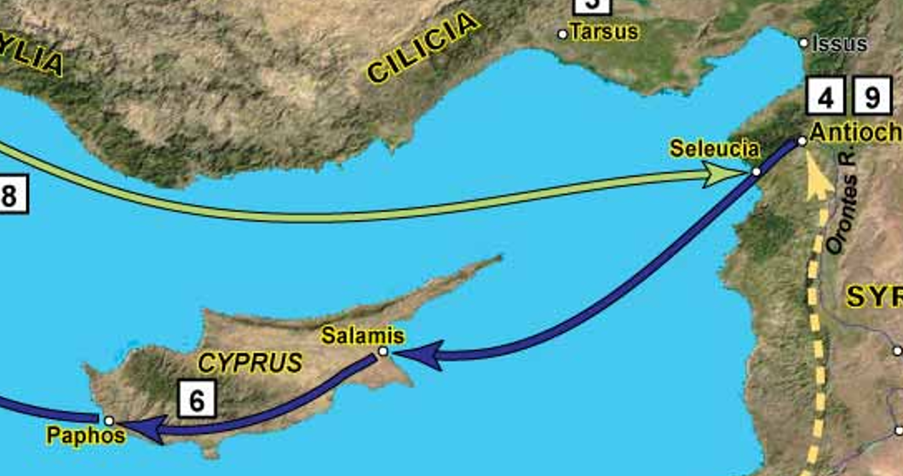
Antioch to Seleucia to Cyprus
Notes:
Ac 13:4 So, being sent out by the Holy Spirit, they went down to Seleucia, and from there they sailed to Cyprus.
Antioch is slightly inland on the Orantes River. They went down to the seacoast city of Seleucia to catch a ship to Cyprus.

Slide 8
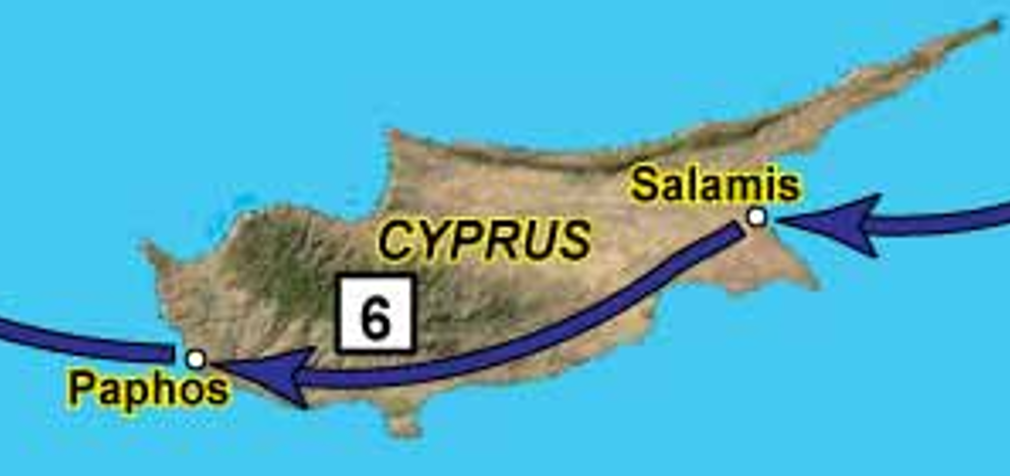
Across Cyprus
In Salamis they preached in the synagogue of the Jews
A common practice of Paul
Gospel had already come to Cyprus (Acts 11:19)
Notes:
Ac 13:5 And when they arrived in Salamis, they preached the word of God in the synagogues of the Jews. They also had John as their assistant.
About Cyprus | Cyprus For Travellers -- It measures 224 kilometers (140 miles) long from end to end and 96 kilometers wide at its widest point, which makes the island’s perimeter greater than that of Crete and Corsica. Source: https://tastecyprus.com/en/cyprus
Albert Barnes—172 miles
Google Maps driving distance Salamis to Paphos—133 miles (lower part of north AL, from Ga line to MS line about 130 miles)
Ac 11:19 Now those who were scattered after the persecution that arose over Stephen traveled as far as Phoenicia, Cyprus, and Antioch, preaching the word to no one but the Jews only.

Slide 9
Bar-Jesus and Sergius Paulus
John Mark is a helper to Barnabas and Saul
Bar-Jesus, a Jew, a sorcerer, a false prophet
Sorcery is listed as a “work of the flesh” (Galatians 5:19-21) and condemned in the OT
Sergius Paulus, an intelligent man
Why would he have Bar-Jesus in his company?
Why would he want to hear from Barnabas and Saul?
Notes:
Ac 13: 6 Now when they had gone through the island to Paphos, they found a certain sorcerer, a false prophet, a Jew whose name was Bar-Jesus,
7 who was with the proconsul, Sergius Paulus, an intelligent man. This man called for Barnabas and Saul and sought to hear the word of God.
Ex 22:18 "You shall not permit a sorceress to live.
Ga 5:19 Now the works of the flesh are evident, which are: adultery, fornication, uncleanness, lewdness,
20 idolatry, sorcery, hatred, contentions, jealousies, outbursts of wrath, selfish ambitions, dissensions, heresies,
21 envy, murders, drunkenness, revelries, and the like; of which I tell you beforehand, just as I also told you in time past, that those who practice such things will not inherit the kingdom of God.
WayneP--
If Sergius Paulus was a "prudent man," why did he have in his presence and confidence a man of such character? Why did he believe in such things? The word prudent means that Sergio Paulo was open-minded, that he investigated things. He was willing to accept the truth, the good, the beneficial, from any source. Sergius Paulus listened to any magician (any wise man). He wanted to hear the word of God! What a good opportunity for Paul and Barnabas! Today there are few men -- and very few eminent men -- who desire to hear the word of God. Paul preached to other eminent men (such as Felix, Festus, Agrippa) and in Rome he made converts even in Caesar's household (Phil. 4:22).
Philip preached to the man from Ethiopia, a man of great authority under Candance, the queen.

Slide 10
Elymas made blind
Elymas interpretation of sorcerer
Why not hear Barnabas and Saul?
He would be exposed as a false prophet if Sergius Paulas listened to Barnabas and Saul
Thus, he would lose his popularity with the proconsul
And his source of income, etc
Notes:
Ac 13:8 But Elymas the sorcerer (for so his name is translated) withstood them, seeking to turn the proconsul away from the faith.
Barnes—
Elymas the magician. Elymas is the interpretation, not of the name Bar-jesus, but of the word rendered the sorcerer. It is an Arabic word, and means the same as magus. It seems that he was better known by this foreign name than by his own.
WayneP—
He did not want to lose the advantage he had with the proconsul or his source of gain and popularity. If the proconsul listened to Paul and Barnabas, Elymas would be exposed as a false prophet and his influence with the proconsul would end. He opposed Paul, therefore, out of interest. Political and economic power, profit, material well-being are the factors that for many men determine who or what they will listen to.

Slide 11
Saul called Paul
Saul is Hebrew; Paul is Roman
It is now Paul and Barnabas (order reversed)
Paul looked intently at Elymas
Paul, moved by the Spirit, rebuked Elymas severely
Elymas is made blind for a time
Notes:
9 Then Saul, who also is called Paul, filled with the Holy Spirit, looked intently at him
10 and said, "O full of all deceit and all fraud, you son of the devil, you enemy of all righteousness, will you not cease perverting the straight ways of the Lord?
11 "And now, indeed, the hand of the Lord is upon you, and you shall be blind, not seeing the sun for a time." And immediately a dark mist fell on him, and he went around seeking someone to lead him by the hand.
He said, "Oh, full of all deception," he tells him what Elymas already knew, that he was a deceiver. Compare Matt. 26:3, 4.
-- and
from all iniquity (vileness, JAV; fraud, HNV), --
-- son of the devil, -- "Bar" means "son"; therefore, his name (Bar-Jesus) meant son of Jesus. But Paul changes his name and calls him son of the devil (which means slanderer). Under the influence of the devil Elymas practiced deception, using the arts of Satan to defraud.
-- Enemy of all righteousness! -- He who lives by wickedness (fraud, deceit) is the enemy of righteousness (integrity, truth).
"Will you not cease to overturn the right ways of the Lord?" "How great is the selfishness of him who takes upon himself the prerogative to change the way of God!" The ways of the Lord are straight and the ways of false teachers are crooked.
It seems that Paul used very harsh language, but it is always an act of kindness to reveal to the sinner his true condition.
WayneP—
Political and economic power, profit, material well-being are the factors that for many men determine who or what they will listen to. They do not investigate the truth, but seek their own convenience. This is his reaction to the word preached.
What is to be done with such a man? A wise man wanted to hear the gospel, but the "wise" man he had respected and listened to prevented him from doing so. It is a bit of a delicate situation. How to deal with it, then? Gently and carefully so as not to offend the proconsul? With kid gloves? No way. Only one thing can be done in such a case, and Paul did it: rebuke sin and expose the false teacher. As Paul said of the work of elders (Titus 1:10, 11), "it is necessary to stop the mouth" of certain individuals.

Slide 12
The proconsul believed
Sergius Paulas believed the preaching of Paul about Jesus
And that Elymas was an imposter
He was astonished at the teaching of the Lord
Signs accompanied the early teaching of the apostles (Mark 16:20; Acts 14:3)
Notes:
Ac 13:12 Then the proconsul believed, when he saw what had been done, being astonished at the teaching of the Lord.
Therefore, it is necessary to expose the error and also the false teacher in order to save those who are led by them to ruin!
Wayne Partain Commentary—
13:12 -- Then the proconsul, seeing what had happened, believed, marveling at the Lord's doctrine. -- This shows the success of Paul's action. It was necessary to completely destroy the trust that Sergius Paulus had in Elymas, so that he could believe the truth. Millions of men and women will never believe the true gospel because they are deceived by their religious leaders (priests, pastors, evangelists, others). Therefore, it is necessary to expose the error and also the false teacher in order to save those who are led by them to ruin!
Many brethren do not want the preachers of the gospel to be negative. They want them to be positive. They don't like to see the error exposed. They feel uncomfortable when the preacher mentions the name of some human church. In this regard, however, we should imitate Christ's example (Matt. 7:15-20; 10:17; 16:6-12; 23; John 7:45-52; 8:44, etc.) and Paul's example (2 Cor. 11:13-15). It is impossible to preach the truth without disturbing or hindering those who teach error, corrupt the truth, and overturn the ways of the Lord.
Joh 8:44 "You are of your father the devil, and the desires of your father you want to do. He was a murderer from the beginning, and does not stand in the truth, because there is no truth in him. When he speaks a lie, he speaks from his own resources, for he is a liar and the father of it.
Ac 13:12 Then the proconsul believed, when he saw what had been done, being astonished at the teaching of the Lord.
Mr 16:20 And they went out and preached everywhere, the Lord working with them and confirming the word through the accompanying signs.
Ac 14:3 Therefore they stayed there [Iconium] a long time, speaking boldly in the Lord, who was bearing witness to the word of His grace, granting signs and wonders to be done by their hands.

Slide 13
Gospel Spreads
You shall be my witnesses
In Jerusalem
In Judea and Samaria
To the end of the earth
Go into all the world
Preached to every creature under heaven
Notes:
Ac 1:8 "But you shall receive power when the Holy Spirit has come upon you; and you shall be witnesses to Me in Jerusalem, and in all Judea and Samaria, and to the end of the earth."
9 Now when He had spoken these things, while they watched, He was taken up, and a cloud received Him out of their sight.
Mr 16:15 And He said to them, "Go into all the world and preach the gospel to every creature.
Col 1:23 if indeed you continue in the faith, grounded and steadfast, and are not moved away from the hope of the gospel which you heard, which was preached to every creature under heaven, of which I, Paul, became a minister.

Slide 14

Slide Title
...

